Slide 1

Video games
sale
Presented by: Joshua Njoku
Last updated

Slide 2
Intro
In this mini project I looked at the top 10 highest sales of video games in Japan, North America, and Europe, in other to gage the most profitable genre of games to develope

Slide 3
Dataset
Sql used
Tableau

Slide 4
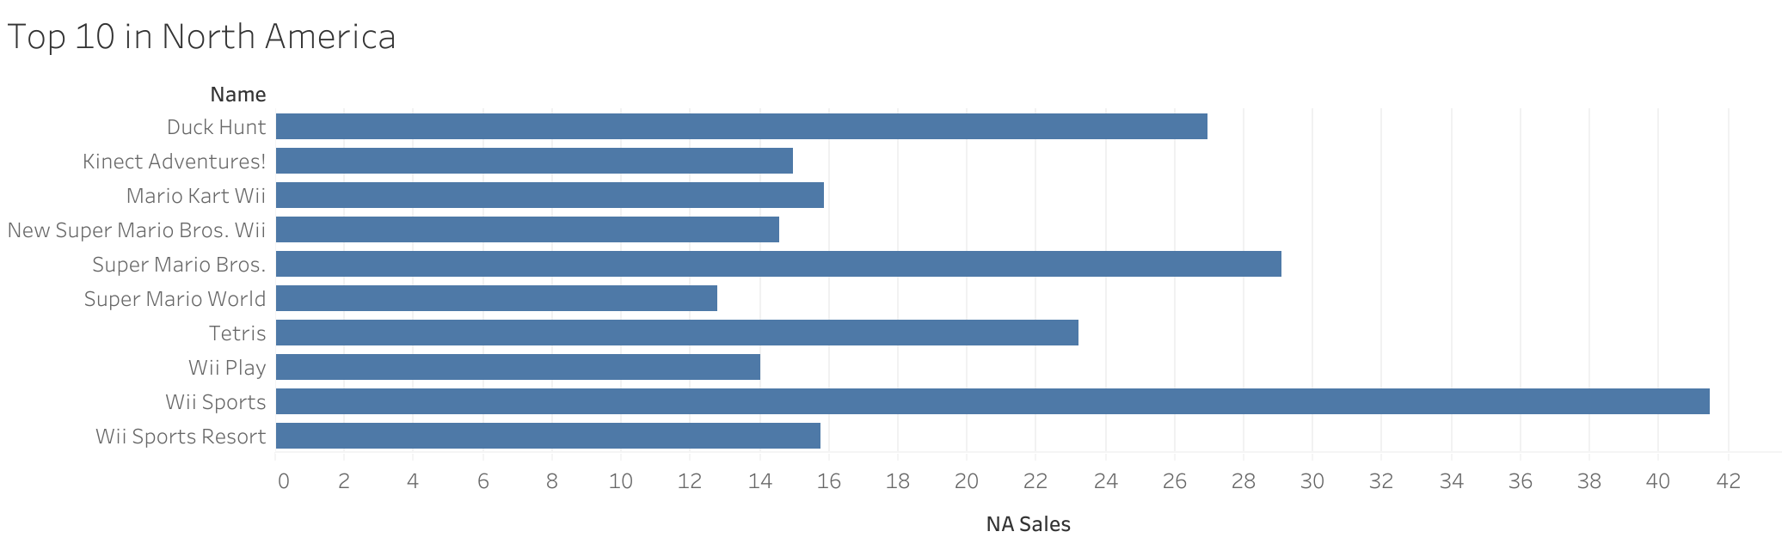
Top sales in America
Wii sports and supper Mario Bros are the top 2 most sold games in north America

Slide 5
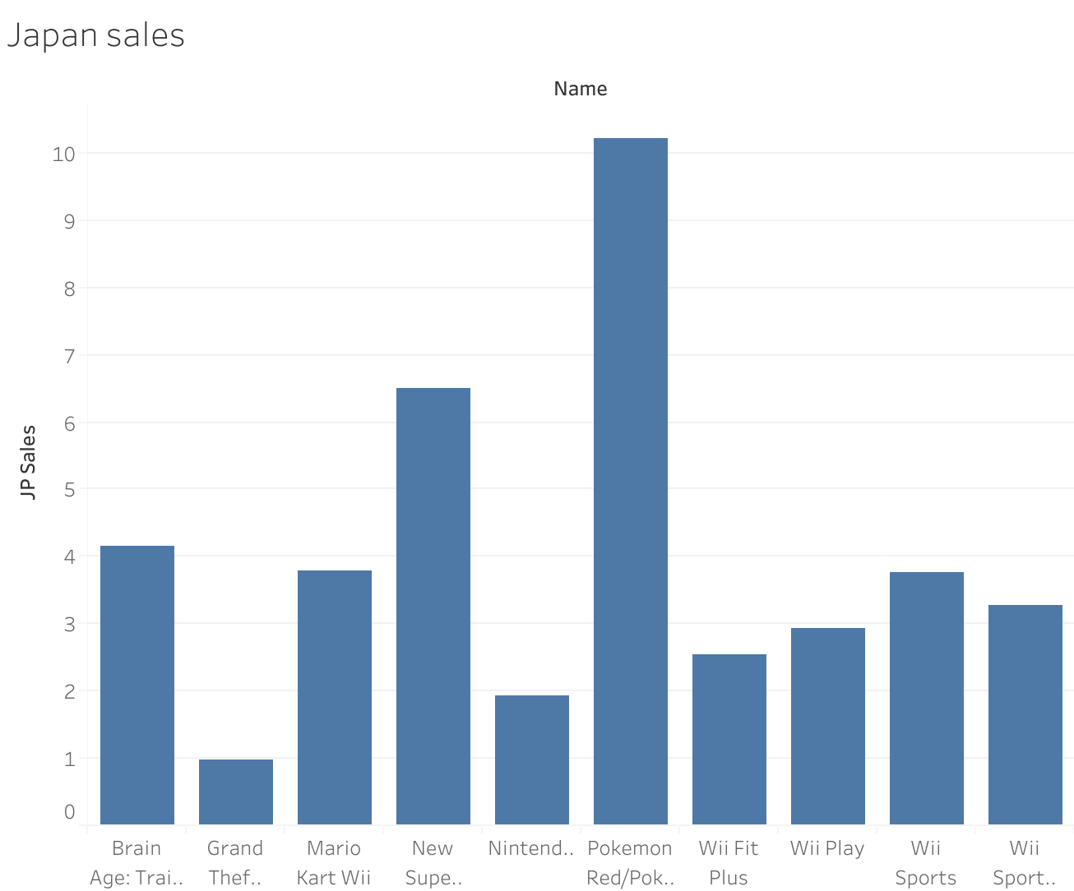
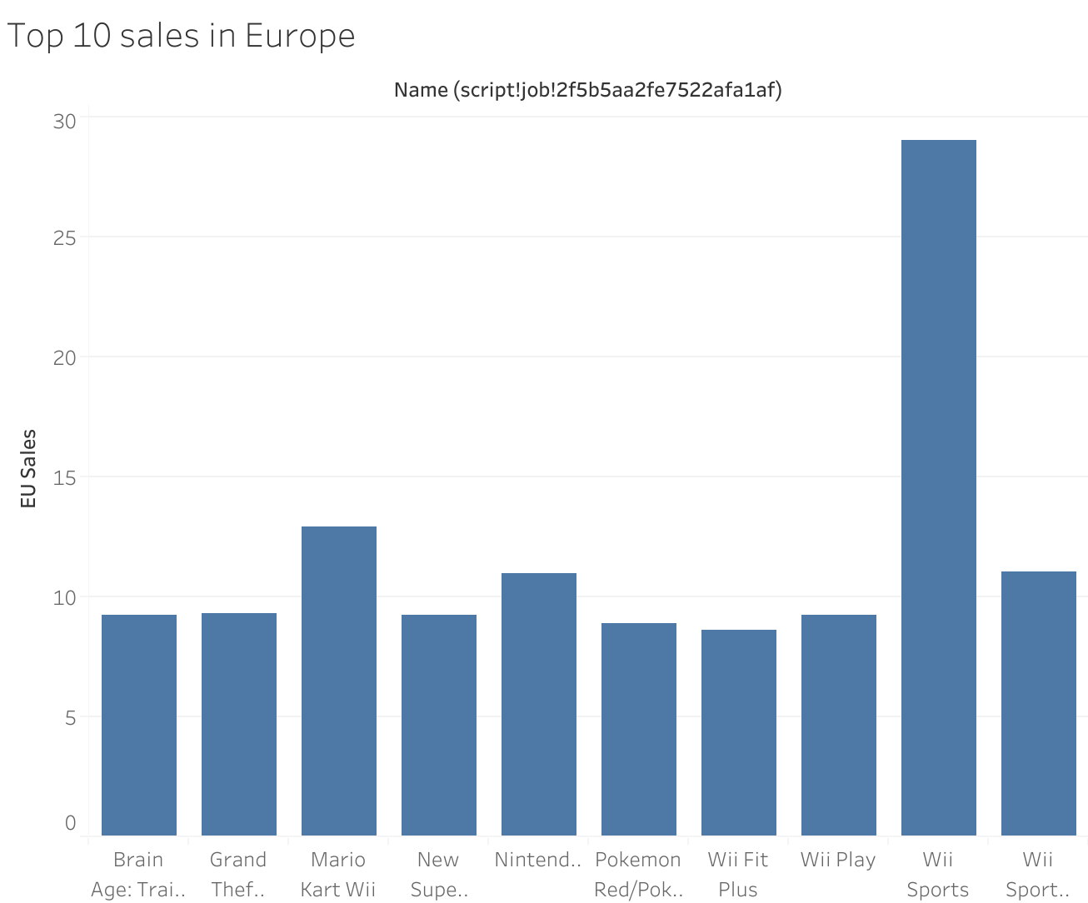
Top sales in EUROPE and Japan
Wii sports and New Supper Mario Bros are top 2 most sold games in Europe
Pokemon blue/Pokemon red and New Supper Mario Bros are the top 2 most sold games in Japan

Slide 6
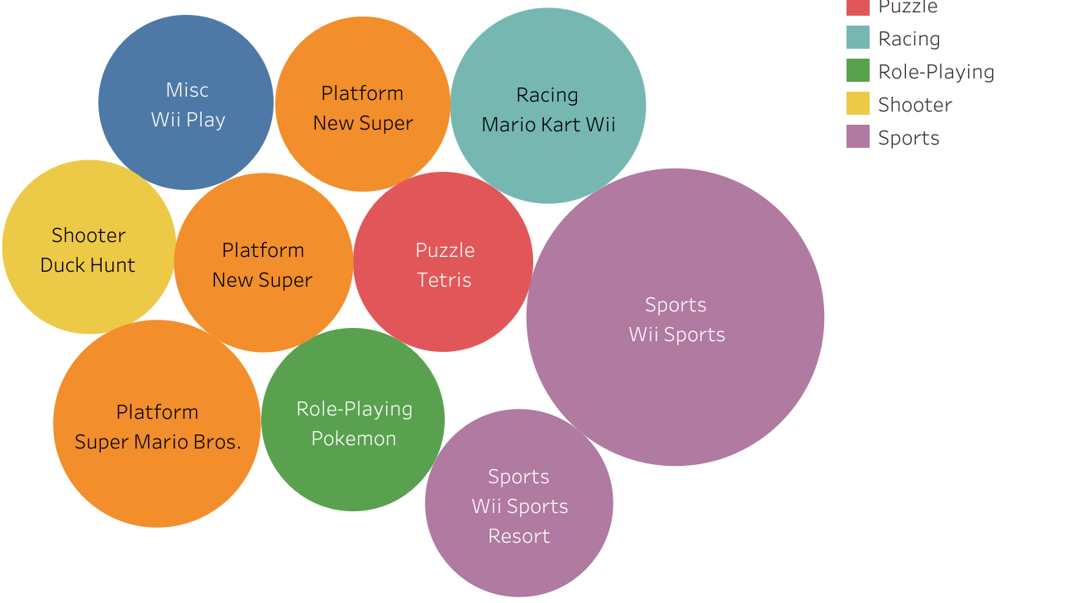
Highest globally
Wii

Slide 7
conclusion
Sports and Platform genre seem to be the most profitable for game developers

